Slide 1
O Progresso tecnológico e a marginalização social Leonardo Nunes Rossato Matheus Rozone De Luca EMC5003 | UFSC | 2019-2
EMC5003 – Tecnologia e desenvolvimento

Slide 2
INTRODUÇÃO
EXPECTATIVA

Slide 3
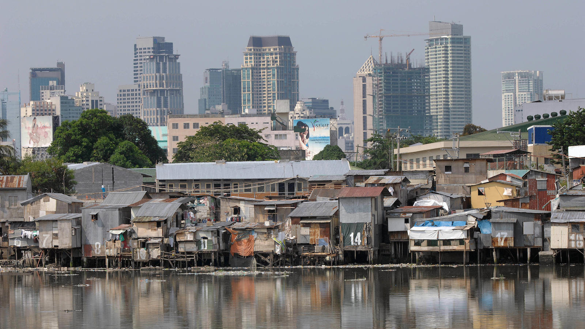
REALIDADE

Slide 4
Agenda
A evolução da tecnologia
Fundamentos da marginalização
A tecnologia e a marginalização social e econômica
Uma nova marginalização: biológica
EMC5003 – Tecnologia e desenvolvimento

Slide 5
Agenda
A evolução da tecnologia
Fundamentos da marginalização
A tecnologia e a marginalização social e econômica
Uma nova marginalização: biológica
EMC5003 – Tecnologia e desenvolvimento

Slide 6
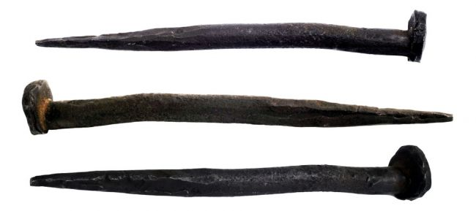
A evolução da tecnologia
3500 a.C
Roda
~ 10 d.C
Prego
~ 900
Bússola
EMC5003 – Tecnologia e desenvolvimento
Notes:
Invenção da roda:
Before the invention of the wheel in 3500 B.C., humans were severely limited in how much stuff we could transport over land, and how far. Invenção do prego
Without nails, civilization would surely crumble. This key invention dates back more than 2,000 years to the Ancient Roman period, and became possible only after humans developed the ability to cast and shape metal. Previously, wood structures had to be built by interlocking adjacent boards geometrically a much more arduous construction process.
Invenção do compasso
The Chinese invented the first compass sometime between the 9th and 11th century; The compass enabled mariners to navigate safely far from land, increasing sea trade and contributing to the Age of Discovery.

Slide 7
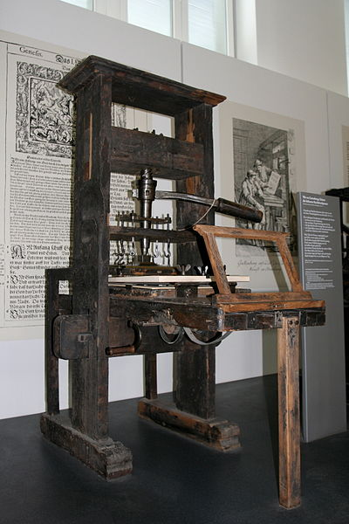
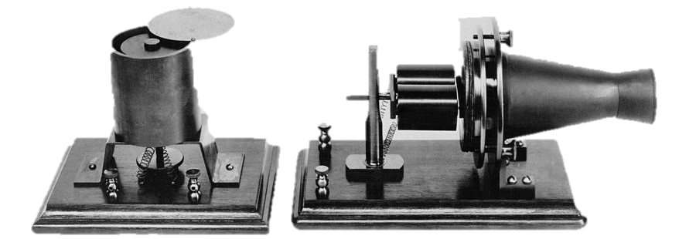
A evolução da tecnologia
Roda
1440
Prensa de impressão
1876
Telefone
1879
Lâmpada
EMC5003 – Tecnologia e desenvolvimento
Notes:
Invenção da prensa de impressão
With this movable type process, printing presses exponentially increased the speed with which book copies could be made, and thus they led to the rapid and widespread dissemination of knowledge for the first time in history. Twenty million volumes had been printed in Western Europe by 1500.

Slide 8
A evolução da tecnologia
Roda
3500 a.C
Penicilina
1928
1930
Contraceptivos
1960
Internet
EMC5003 – Tecnologia e desenvolvimento
Notes:
Penicilina
It's one of the most famous discovery stories in history. In 1928, the Scottish scientist Alexander Fleming noticed a bacteria-filled Petri dish in his laboratory with its lid accidentally ajar. The sample had become contaminated with a mold, and everywhere the mold was, the bacteria was dead. That antibiotic mold turned out to be the fungus Penicillium, and over the next two decades, chemists purified it and developed the drug Penicillin, which fights a huge number of bacterial infections in humans without harming the humans themselves.
Penicillin was being mass produced and advertised by 1944. This poster attached to a curbside mailbox advised World War II servicemen to take the drug to rid themselves of venereal disease.
About 1 in 10 people have an allergic reaction to the antibiotic, according to study published in 2003 in the journal Clinical Reviews in Allergy and Immunology; even so most of those people go on to be able to tolerate the drug, researchers said.
Contraceptivos
Not only have birth control pills, condoms and other forms of contraception sparked a sexual revolution in the developed world by allowing men and women to have sex for leisure rather than procreation, they have also drastically reduced the average number of offspring per woman in countries where they are used. With fewer mouths to feed, modern families have achieved higher standards of living and can provide better for each child. Meanwhile, on the global scale, contraceptives are helping the human population gradually level off; our number will probably stabilize by the end of the century. Certain contraceptives, such as condoms, also curb the spread of sexually transmitted diseases.
Internet

Slide 9
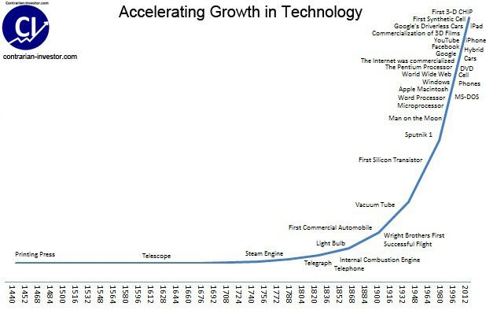
A evolução da tecnologia
[Contrarian Investor]
EMC5003 – Tecnologia e desenvolvimento
Notes:
Penicilina
It's one of the most famous discovery stories in history. In 1928, the Scottish scientist Alexander Fleming noticed a bacteria-filled Petri dish in his laboratory with its lid accidentally ajar. The sample had become contaminated with a mold, and everywhere the mold was, the bacteria was dead. That antibiotic mold turned out to be the fungus Penicillium, and over the next two decades, chemists purified it and developed the drug Penicillin, which fights a huge number of bacterial infections in humans without harming the humans themselves.
Penicillin was being mass produced and advertised by 1944. This poster attached to a curbside mailbox advised World War II servicemen to take the drug to rid themselves of venereal disease.
About 1 in 10 people have an allergic reaction to the antibiotic, according to study published in 2003 in the journal Clinical Reviews in Allergy and Immunology; even so most of those people go on to be able to tolerate the drug, researchers said.
Contraceptivos
Not only have birth control pills, condoms and other forms of contraception sparked a sexual revolution in the developed world by allowing men and women to have sex for leisure rather than procreation, they have also drastically reduced the average number of offspring per woman in countries where they are used. With fewer mouths to feed, modern families have achieved higher standards of living and can provide better for each child. Meanwhile, on the global scale, contraceptives are helping the human population gradually level off; our number will probably stabilize by the end of the century. Certain contraceptives, such as condoms, also curb the spread of sexually transmitted diseases.
Internet

Slide 10
Agenda
A evolução da tecnologia
Fundamentos da marginalização
A tecnologia e a marginalização social e econômica
Uma nova marginalização: biológica
EMC5003 – Tecnologia e desenvolvimento

Slide 11
Fundamentos da marginalização
Conceito
Processos nos quais indivíduos são separados do resto da sociedade com base em suas identidades, associações, sexualidade, experiências e/ou meio.
EMC5003 – Tecnologia e desenvolvimento

Slide 12
Fundamentos da marginalização
Conceito
Tais processos evitam que certos grupos possuam igual e efetiva participação social, econômica, cultural e política na sociedade.
EMC5003 – Tecnologia e desenvolvimento

Slide 13
Fundamentos da marginalização
Problemática
Desigualdade social.
Preconceito.
Violência.
Pobreza.
Desemprego.
EMC5003 – Tecnologia e desenvolvimento

Slide 14
Fundamentos da marginalização
Tipos
Marginalização econômica.
Marginalização social.
Marginalização cultural.
Marginalização política.
Marginalização “biológica”
Onde a influência da tecnologia se faz mais presente?
EMC5003 – Tecnologia e desenvolvimento

Slide 15
Agenda
A evolução da tecnologia
Fundamentos da marginalização
A tecnologia e a marginalização social e econômica
Uma nova marginalização: biológica
EMC5003 – Tecnologia e desenvolvimento

Slide 16
Marginalização social/econômica e o progresso tecnológico
Contextualização
Desenvolvimentos tecnológicos para quem?
TED TALK: “Veja como o resto do mundo vive organizado pela renda”
https://www.youtube.com/watch?v=u4L130DkdOw&t=53s
https://www.gapminder.org/dollar-street/matrix
EMC5003 – Tecnologia e desenvolvimento

Slide 17
Marginalização social/econômica e o progresso tecnológico
Contextualização
Lucro?
Tecnologias acessíveis a pessoas de baixa renda?
Eficiência?
x
EMC5003 – Tecnologia e desenvolvimento

Slide 18
Marginalização social/econômica e o progresso tecnológico
Dados
Pobreza extrema: < 7,8 reais.
Linha de pobreza: < 13,1 reais (países renda média-baixa)
Linha de pobreza: < 22,6 reais. (países renda média-alta)
(Por dia)
Brasil: 687,4 reais por mês.
EMC5003 – Tecnologia e desenvolvimento

Slide 19
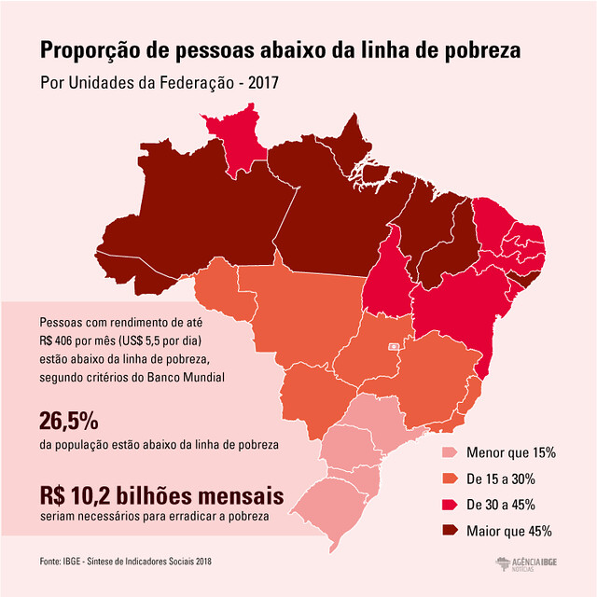
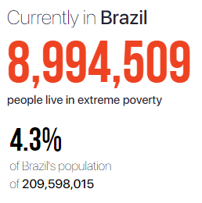
Marginalização social/econômica e o progresso tecnológico
Dados
EMC5003 – Tecnologia e desenvolvimento

Slide 20
Marginalização social/econômica e o progresso tecnológico
Dados
Censo IBGE 2010
TV: 95,1%
Geladeira: 93,7%
Máquina de lavar: 47,3%
Telefone fixo ou celular: 87,9%
ONU 2015
Acesso à internet: 58%
EMC5003 – Tecnologia e desenvolvimento

Slide 21
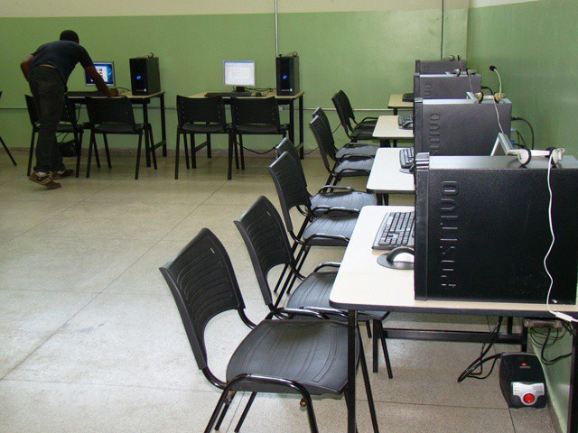
Marginalização social/econômica e o progresso tecnológico
Discussão
A tecnologia pode acabar com a pobreza?
Telecentros → Comunidades pobres
Ensaio de Kentaro Toyama (cientista da computação que pesquisa a aplicação de tecnologia ao desenvolvimento internacional)
EMC5003 – Tecnologia e desenvolvimento

Slide 22
Marginalização social/econômica e o progresso tecnológico
A tecnologia pode acabar com a pobreza?
Grandes expectativas →transformar cada criança num acadêmico; a curar os problemas do sistema de saúde rural (telemedicina)...
Os sucessos dos telecentros são poucos, efêmeros e distantes entre si → despesas mensais com infraestrutura e manutenção altos.
Ensaio de Kentaro Toyama
EMC5003 – Tecnologia e desenvolvimento

Slide 23
Marginalização social/econômica e o progresso tecnológico
A tecnologia pode acabar com a pobreza?
Por que estas iniciativas falharam?
Tecnologia não era apropriada ao contexto.
Fornecimento de energia precário.
Não convidam a comunidade a participar.
Não oferecem serviços que atendam às necessidades locais.
Não considerem problemas de transporte e infraestrutura.
Ensaio de Kentaro Toyama
EMC5003 – Tecnologia e desenvolvimento

Slide 24
Marginalização social/econômica e o progresso tecnológico
A tecnologia pode acabar com a pobreza?
“A tecnologia é apenas um amplificador das capacidades e das intenções humanas. Ela não é um substituto. “
A tecnologia não é capaz de resolver os problemas se há má administração.
Ensaio de Kentaro Toyama
EMC5003 – Tecnologia e desenvolvimento

Slide 25
Marginalização social/econômica e o progresso tecnológico
A tecnologia pode acabar com a pobreza?
“É mais fácil espalhar tecnologia do que efetuar uma profunda mudança em atitudes sociais e na capacidade humana.
“É muito menos custoso adquirir cem mil computadores do que prover uma educação de verdade para cem mil crianças.”
Tecnologia = progresso?
Ensaio de Kentaro Toyama
EMC5003 – Tecnologia e desenvolvimento

Slide 26
Marginalização social/econômica e o progresso tecnológico
A tecnologia pode acabar com a pobreza?
“Quanto maior a capacidade de uma pessoa, mais ela se beneficia da tecnologia. Quanto menos uma pessoa sabe, menos valor tem sua tecnologia. “
Na prática, a tecnologia ajuda os ricos a enriquecer enquanto pouco faz pela renda dos mais pobres, aumentando a desigualdade entre eles
Ensaio de Kentaro Toyama
EMC5003 – Tecnologia e desenvolvimento

Slide 27
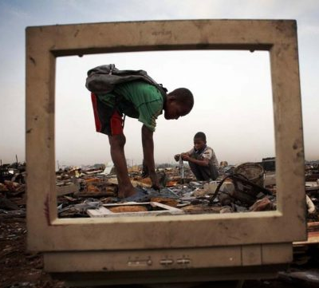
Marginalização social/econômica e o progresso tecnológico
A tecnologia pode acabar com a pobreza?
Os três mecanismos que aprofundam esta desigualdade:
1- Diferencial de acesso: tecnologia é mais acessível aos ricos e aos poderosos.
Manutenção
Instrução
Operação
Ensaio de Kentaro Toyama
EMC5003 – Tecnologia e desenvolvimento

Slide 28
Marginalização social/econômica e o progresso tecnológico
A tecnologia pode acabar com a pobreza?
Os três mecanismos que aprofundam esta desigualdade:
2-Barreiras sociais: “Muitos dos telecentros que visitei no mundo não eram acessíveis aos menos privilegiados do local por injunções sociais.”
Ensaio de Kentaro Toyama
EMC5003 – Tecnologia e desenvolvimento

Slide 29
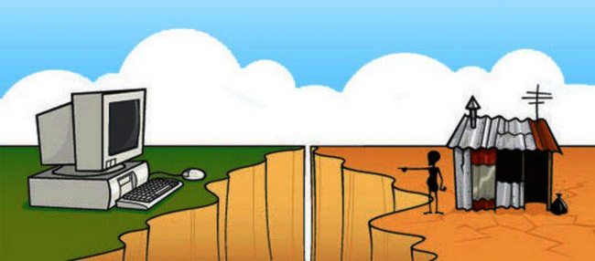
Marginalização social/econômica e o progresso tecnológico
A tecnologia pode acabar com a pobreza?
Os três mecanismos que aprofundam esta desigualdade:
3-Exclusão digital:
Mais lucro → busca consumidores por ricos
Ensaio de Kentaro Toyama
EMC5003 – Tecnologia e desenvolvimento

Slide 30
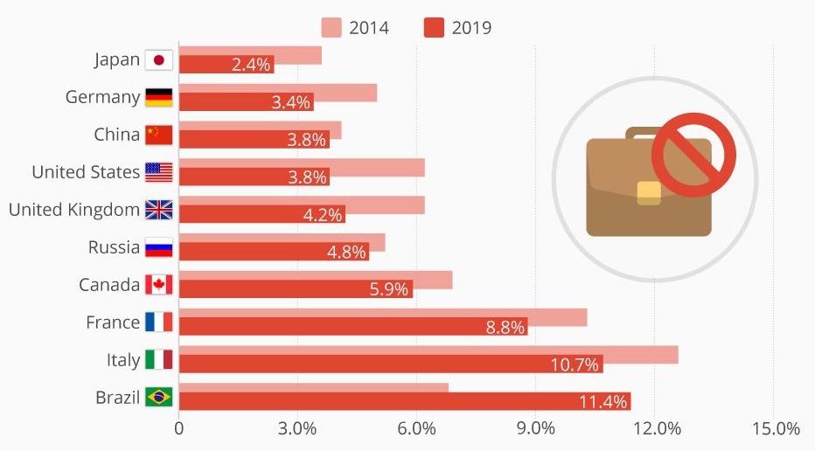
Marginalização social/econômica e o progresso tecnológico
Desemprego
Brasil: 12% da população
12,8 milhões
EMC5003 – Tecnologia e desenvolvimento

Slide 31
Marginalização social/econômica e o progresso tecnológico
Desemprego
“Uma nova classe de pessoas deve surgir até 2050: a dos inúteis”
"Com o avanço da inteligência artificial, os humanos serão substituídos na maioria dos trabalhos que hoje existem. Novas profissões irão surgir, mas nem todos conseguirão se reinventar e se qualificar para essas funções.
"São pessoas que não serão apenas
desempregadas, mas que não serão empregáveis"
Yuval Noah Harari
EMC5003 – Tecnologia e desenvolvimento

Slide 32
Marginalização social/econômica e o progresso tecnológico
Desemprego
“Uma nova classe de pessoas deve surgir até 2050: a dos inúteis”
O que essas pessoas fariam o dia todo?
Uma das possíveis soluções, apontadas pelo professor, são os games de realidade virtual em 3D.“Na verdade, essa é uma solução muito antiga. No passado, chamávamos esses jogos de ‘religiões’”
Yuval Noah Harari
EMC5003 – Tecnologia e desenvolvimento

Slide 33
Agenda
A evolução da tecnologia
Fundamentos da marginalização
A tecnologia e a marginalização social e econômica
Uma nova marginalização: biológica
EMC5003 – Tecnologia e desenvolvimento

Slide 34
Uma nova marginalização: biológica
Contextualização
EMC5003 – Tecnologia e desenvolvimento
Notes:
Biomedical engineering is an interdisciplinary field of study that integrates knowledge of engineering principles with the biomedical sciences. Biomedical engineers work in the design, production, development, operation, and maintenance of medical devices and systems used for diagnostics and therapeutics such as systems for imaging and medical robotics. Consequently, they work closely with professionals from other engineering disciplines and basic sciences as well as medical staff like MDs, nurses and technicians.

Slide 35
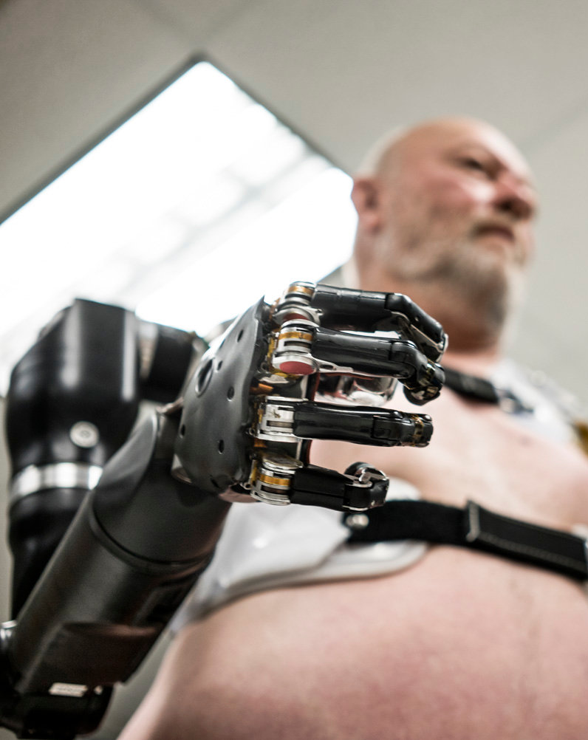
Uma nova marginalização: biológica
Contextualização
Prevenção
Cura
Reabilitação
Aperfeiçoamento
EMC5003 – Tecnologia e desenvolvimento
Notes:
Biomedical engineering is an interdisciplinary field of study that integrates knowledge of engineering principles with the biomedical sciences. Biomedical engineers work in the design, production, development, operation, and maintenance of medical devices and systems used for diagnostics and therapeutics such as systems for imaging and medical robotics. Consequently, they work closely with professionals from other engineering disciplines and basic sciences as well as medical staff like MDs, nurses and technicians.

Slide 36
Uma nova marginalização: biológica
Discussão
Haverá acesso universal a esse tipo de tecnologia?
[World Health Organization]
EMC5003 – Tecnologia e desenvolvimento
Notes:
Biomedical engineering is an interdisciplinary field of study that integrates knowledge of engineering principles with the biomedical sciences. Biomedical engineers work in the design, production, development, operation, and maintenance of medical devices and systems used for diagnostics and therapeutics such as systems for imaging and medical robotics. Consequently, they work closely with professionals from other engineering disciplines and basic sciences as well as medical staff like MDs, nurses and technicians.

Slide 37
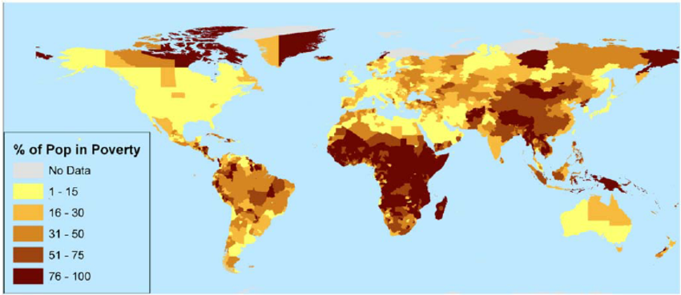
Uma nova marginalização: biológica
Discussão
Haverá acesso universal a esse tipo de tecnologia?
Países com saúde pública
Países por índice de pobreza
[Berkeley Political Review]
[“A global poverty map derived from satellite data”]
EMC5003 – Tecnologia e desenvolvimento
Notes:
Biomedical engineering is an interdisciplinary field of study that integrates knowledge of engineering principles with the biomedical sciences. Biomedical engineers work in the design, production, development, operation, and maintenance of medical devices and systems used for diagnostics and therapeutics such as systems for imaging and medical robotics. Consequently, they work closely with professionals from other engineering disciplines and basic sciences as well as medical staff like MDs, nurses and technicians.

Slide 38
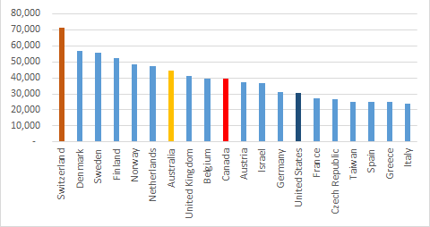
Uma nova marginalização: biológica
Discussão
Países classificados por número de citações a cada um milhão de habitantes
Foco das pesquisas: barateamento ou otimização?
[Scimago Institutions Rankings]
38
EMC5003 – Tecnologia e desenvolvimento
Notes:
Penicilina
It's one of the most famous discovery stories in history. In 1928, the Scottish scientist Alexander Fleming noticed a bacteria-filled Petri dish in his laboratory with its lid accidentally ajar. The sample had become contaminated with a mold, and everywhere the mold was, the bacteria was dead. That antibiotic mold turned out to be the fungus Penicillium, and over the next two decades, chemists purified it and developed the drug Penicillin, which fights a huge number of bacterial infections in humans without harming the humans themselves.
Penicillin was being mass produced and advertised by 1944. This poster attached to a curbside mailbox advised World War II servicemen to take the drug to rid themselves of venereal disease.
About 1 in 10 people have an allergic reaction to the antibiotic, according to study published in 2003 in the journal Clinical Reviews in Allergy and Immunology; even so most of those people go on to be able to tolerate the drug, researchers said.
Contraceptivos
Not only have birth control pills, condoms and other forms of contraception sparked a sexual revolution in the developed world by allowing men and women to have sex for leisure rather than procreation, they have also drastically reduced the average number of offspring per woman in countries where they are used. With fewer mouths to feed, modern families have achieved higher standards of living and can provide better for each child. Meanwhile, on the global scale, contraceptives are helping the human population gradually level off; our number will probably stabilize by the end of the century. Certain contraceptives, such as condoms, also curb the spread of sexually transmitted diseases.
Internet

Slide 39
Uma nova marginalização: biológica
Será o fim da meritocracia?
39
EMC5003 – Tecnologia e desenvolvimento
Notes:
Penicilina
It's one of the most famous discovery stories in history. In 1928, the Scottish scientist Alexander Fleming noticed a bacteria-filled Petri dish in his laboratory with its lid accidentally ajar. The sample had become contaminated with a mold, and everywhere the mold was, the bacteria was dead. That antibiotic mold turned out to be the fungus Penicillium, and over the next two decades, chemists purified it and developed the drug Penicillin, which fights a huge number of bacterial infections in humans without harming the humans themselves.
Penicillin was being mass produced and advertised by 1944. This poster attached to a curbside mailbox advised World War II servicemen to take the drug to rid themselves of venereal disease.
About 1 in 10 people have an allergic reaction to the antibiotic, according to study published in 2003 in the journal Clinical Reviews in Allergy and Immunology; even so most of those people go on to be able to tolerate the drug, researchers said.
Contraceptivos
Not only have birth control pills, condoms and other forms of contraception sparked a sexual revolution in the developed world by allowing men and women to have sex for leisure rather than procreation, they have also drastically reduced the average number of offspring per woman in countries where they are used. With fewer mouths to feed, modern families have achieved higher standards of living and can provide better for each child. Meanwhile, on the global scale, contraceptives are helping the human population gradually level off; our number will probably stabilize by the end of the century. Certain contraceptives, such as condoms, also curb the spread of sexually transmitted diseases.
Internet

Slide 40
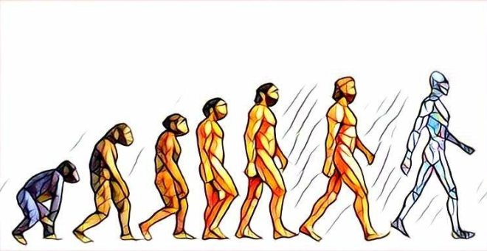
Uma nova marginalização: biológica
Será o surgimento de uma nova espécie?
E a extinção da anterior?
40
EMC5003 – Tecnologia e desenvolvimento
Notes:
Penicilina
It's one of the most famous discovery stories in history. In 1928, the Scottish scientist Alexander Fleming noticed a bacteria-filled Petri dish in his laboratory with its lid accidentally ajar. The sample had become contaminated with a mold, and everywhere the mold was, the bacteria was dead. That antibiotic mold turned out to be the fungus Penicillium, and over the next two decades, chemists purified it and developed the drug Penicillin, which fights a huge number of bacterial infections in humans without harming the humans themselves.
Penicillin was being mass produced and advertised by 1944. This poster attached to a curbside mailbox advised World War II servicemen to take the drug to rid themselves of venereal disease.
About 1 in 10 people have an allergic reaction to the antibiotic, according to study published in 2003 in the journal Clinical Reviews in Allergy and Immunology; even so most of those people go on to be able to tolerate the drug, researchers said.
Contraceptivos
Not only have birth control pills, condoms and other forms of contraception sparked a sexual revolution in the developed world by allowing men and women to have sex for leisure rather than procreation, they have also drastically reduced the average number of offspring per woman in countries where they are used. With fewer mouths to feed, modern families have achieved higher standards of living and can provide better for each child. Meanwhile, on the global scale, contraceptives are helping the human population gradually level off; our number will probably stabilize by the end of the century. Certain contraceptives, such as condoms, also curb the spread of sexually transmitted diseases.
Internet

Slide 41
Uma nova marginalização: biológica
E qual é a conclusão final?
Cessar todos os investimentos no setor?
Proibição de pesquisas nesse campo?
41
EMC5003 – Tecnologia e desenvolvimento
Notes:
Penicilina
It's one of the most famous discovery stories in history. In 1928, the Scottish scientist Alexander Fleming noticed a bacteria-filled Petri dish in his laboratory with its lid accidentally ajar. The sample had become contaminated with a mold, and everywhere the mold was, the bacteria was dead. That antibiotic mold turned out to be the fungus Penicillium, and over the next two decades, chemists purified it and developed the drug Penicillin, which fights a huge number of bacterial infections in humans without harming the humans themselves.
Penicillin was being mass produced and advertised by 1944. This poster attached to a curbside mailbox advised World War II servicemen to take the drug to rid themselves of venereal disease.
About 1 in 10 people have an allergic reaction to the antibiotic, according to study published in 2003 in the journal Clinical Reviews in Allergy and Immunology; even so most of those people go on to be able to tolerate the drug, researchers said.
Contraceptivos
Not only have birth control pills, condoms and other forms of contraception sparked a sexual revolution in the developed world by allowing men and women to have sex for leisure rather than procreation, they have also drastically reduced the average number of offspring per woman in countries where they are used. With fewer mouths to feed, modern families have achieved higher standards of living and can provide better for each child. Meanwhile, on the global scale, contraceptives are helping the human population gradually level off; our number will probably stabilize by the end of the century. Certain contraceptives, such as condoms, also curb the spread of sexually transmitted diseases.
Internet

Slide 42
Uma nova marginalização: biológica
Proposta de solução
Criação de Comitês de Ética responsáveis por avaliar as propostas de pesquisa na área
Foco de investimento no barateamento dessas tecnologias;
Conscientização global dos possíveis danos colaterais desse tipo de pesquisa;
Amadurecimento da sociedade em relação aos limites da evolução humana como espécie;
42
EMC5003 – Tecnologia e desenvolvimento
Notes:
Penicilina
It's one of the most famous discovery stories in history. In 1928, the Scottish scientist Alexander Fleming noticed a bacteria-filled Petri dish in his laboratory with its lid accidentally ajar. The sample had become contaminated with a mold, and everywhere the mold was, the bacteria was dead. That antibiotic mold turned out to be the fungus Penicillium, and over the next two decades, chemists purified it and developed the drug Penicillin, which fights a huge number of bacterial infections in humans without harming the humans themselves.
Penicillin was being mass produced and advertised by 1944. This poster attached to a curbside mailbox advised World War II servicemen to take the drug to rid themselves of venereal disease.
About 1 in 10 people have an allergic reaction to the antibiotic, according to study published in 2003 in the journal Clinical Reviews in Allergy and Immunology; even so most of those people go on to be able to tolerate the drug, researchers said.
Contraceptivos
Not only have birth control pills, condoms and other forms of contraception sparked a sexual revolution in the developed world by allowing men and women to have sex for leisure rather than procreation, they have also drastically reduced the average number of offspring per woman in countries where they are used. With fewer mouths to feed, modern families have achieved higher standards of living and can provide better for each child. Meanwhile, on the global scale, contraceptives are helping the human population gradually level off; our number will probably stabilize by the end of the century. Certain contraceptives, such as condoms, also curb the spread of sexually transmitted diseases.
Internet

Slide 43
O espírito humano deve prevalecer sobre a tecnologia
- Albert Einstein

Slide 44
Referências bibliográficas
[1] https://bpr.berkeley.edu/2017/01/23/tried-and-true-obamacare-and-the-nationalization-of-american-policy/
[2] https://www.quora.com/What-countries-have-lead-the-world-in-medical-research-and-innovation-during-the-time-period-between-1995-and-2014
[3] https://www.scimagojr.com/countryrank.php
[4] https://medium.com/timeline-of-technology/calculating-human-progress-c400da57aa13
[5] https://www.who.int/news-room/detail/13-12-2017-world-bank-and-who-half-the-world-lacks-access-to-essential-health-services-100-million-still-pushed-into-extreme-poverty-because-of-health-expenses
[6] https://pt.wikipedia.org/wiki/Marginaliza%C3%A7%C3%A3o
[7] https://www.theguardian.com/technology/2017/may/08/virtual-reality-religion-robots-sapiens-book
[8] https://www.infoescola.com/sociologia/marginalizacao/
[9] https://www.todamateria.com.br/o-que-e-marginalizacao/
[10] https://www.slideshare.net/gideonite/marginalization-and-economic-developmentthe-role-of-human-right
44
EMC5003 – Tecnologia e desenvolvimento
Notes:
Penicilina
It's one of the most famous discovery stories in history. In 1928, the Scottish scientist Alexander Fleming noticed a bacteria-filled Petri dish in his laboratory with its lid accidentally ajar. The sample had become contaminated with a mold, and everywhere the mold was, the bacteria was dead. That antibiotic mold turned out to be the fungus Penicillium, and over the next two decades, chemists purified it and developed the drug Penicillin, which fights a huge number of bacterial infections in humans without harming the humans themselves.
Penicillin was being mass produced and advertised by 1944. This poster attached to a curbside mailbox advised World War II servicemen to take the drug to rid themselves of venereal disease.
About 1 in 10 people have an allergic reaction to the antibiotic, according to study published in 2003 in the journal Clinical Reviews in Allergy and Immunology; even so most of those people go on to be able to tolerate the drug, researchers said.
Contraceptivos
Not only have birth control pills, condoms and other forms of contraception sparked a sexual revolution in the developed world by allowing men and women to have sex for leisure rather than procreation, they have also drastically reduced the average number of offspring per woman in countries where they are used. With fewer mouths to feed, modern families have achieved higher standards of living and can provide better for each child. Meanwhile, on the global scale, contraceptives are helping the human population gradually level off; our number will probably stabilize by the end of the century. Certain contraceptives, such as condoms, also curb the spread of sexually transmitted diseases.
Internet

Slide 45
Referências bibliográficas
[11] https://nacoesunidas.org/banco-mundial-quase-metade-da-populacao-global-vive-abaixo-da-linha-da-pobreza/[12] https://www.quora.com/What-countries-have-lead-the-world-in-medical-research-and-innovation-during-the-time-period-between-1995-and-2014
[13] https://www.brasildefato.com.br/2018/12/07/em-um-ano-numero-de-pobres-no-brasil-sobe-para-548-milhoes/
[14] https://www.em.com.br/app/noticia/economia/2018/12/05/internas_economia,1010671/em-2017-quase-55-milhoes-de-brasileiros-estavam-abaixo-da-linha-de-po.shtml
[15] https://www1.folha.uol.com.br/mercado/2019/07/taxa-de-desemprego-cai-e-fica-em-12-no-segundo-trimestre-de-2019.shtml
[16] https://medium.com/@rntpincelli/a-tecnologia-pode-acabar-com-a-pobreza-37d93f71cae
[17] https://www.tecmundo.com.br/tecnologia/102284-comunidades-carentes-usando-tecnologia-favor.htm
45
EMC5003 – Tecnologia e desenvolvimento
Notes:
Penicilina
It's one of the most famous discovery stories in history. In 1928, the Scottish scientist Alexander Fleming noticed a bacteria-filled Petri dish in his laboratory with its lid accidentally ajar. The sample had become contaminated with a mold, and everywhere the mold was, the bacteria was dead. That antibiotic mold turned out to be the fungus Penicillium, and over the next two decades, chemists purified it and developed the drug Penicillin, which fights a huge number of bacterial infections in humans without harming the humans themselves.
Penicillin was being mass produced and advertised by 1944. This poster attached to a curbside mailbox advised World War II servicemen to take the drug to rid themselves of venereal disease.
About 1 in 10 people have an allergic reaction to the antibiotic, according to study published in 2003 in the journal Clinical Reviews in Allergy and Immunology; even so most of those people go on to be able to tolerate the drug, researchers said.
Contraceptivos
Not only have birth control pills, condoms and other forms of contraception sparked a sexual revolution in the developed world by allowing men and women to have sex for leisure rather than procreation, they have also drastically reduced the average number of offspring per woman in countries where they are used. With fewer mouths to feed, modern families have achieved higher standards of living and can provide better for each child. Meanwhile, on the global scale, contraceptives are helping the human population gradually level off; our number will probably stabilize by the end of the century. Certain contraceptives, such as condoms, also curb the spread of sexually transmitted diseases.
Internet

